Slide 1

5G NR
5’th Generation
New Ratio

Slide 2
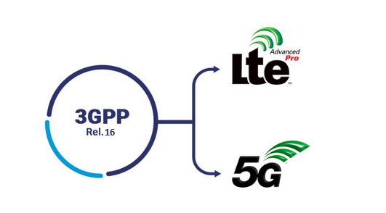
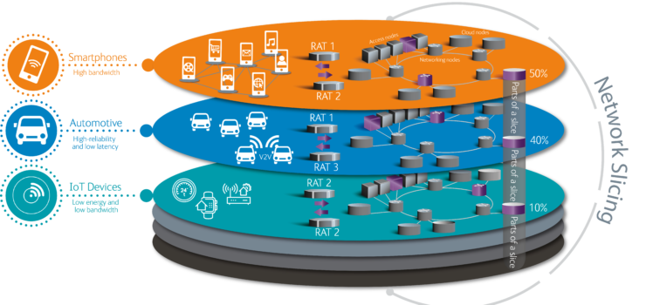
What is 5G?

Slide 3
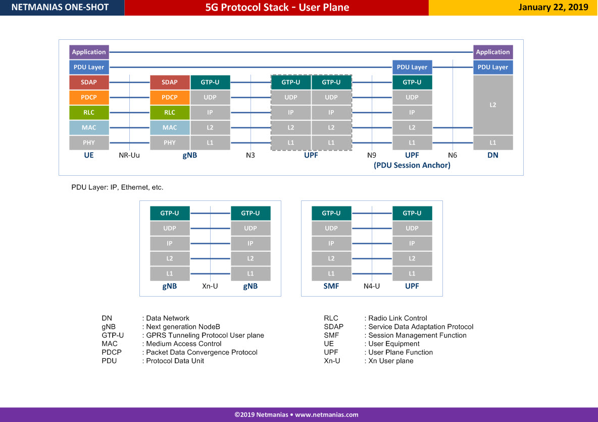

Slide 4
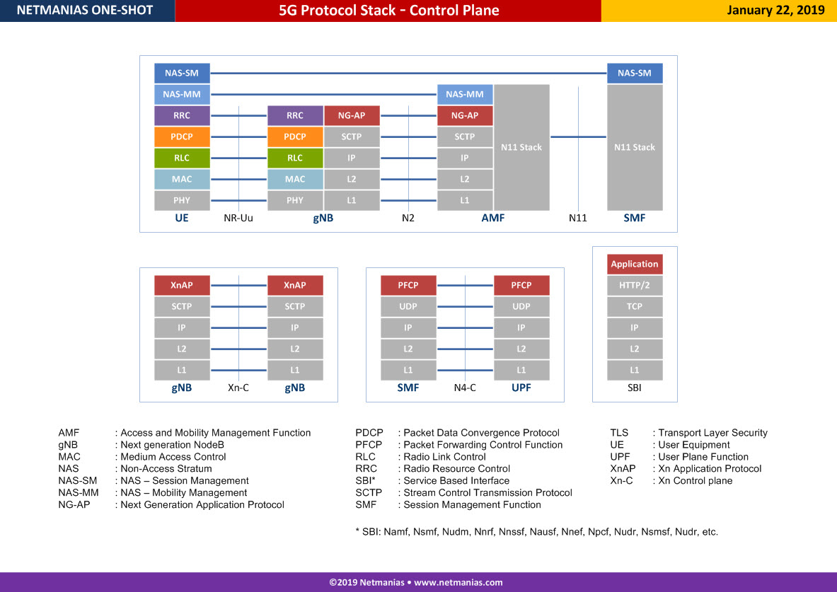

Slide 5
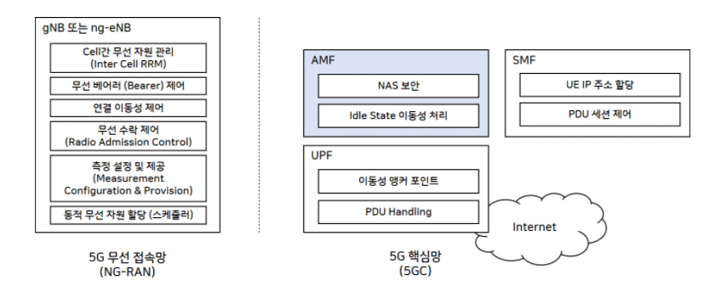
What is gNB/AMF/SMF?
Authentication management
Sesson management

Slide 6
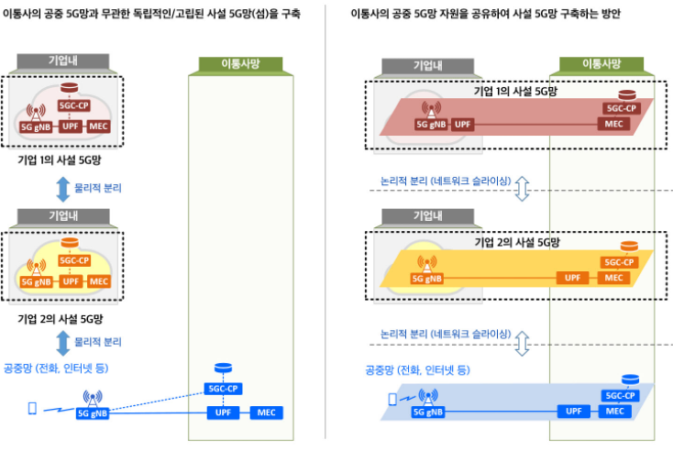
What is gNB/AMF/SMF?

Slide 8
5GMM Specific Procedures
Register / Deregister
Service Request
Paging
E-Call, Notification
굉장히 특수한 상황 혹은 주로 SM Message

Slide 10
Register Request

Slide 11
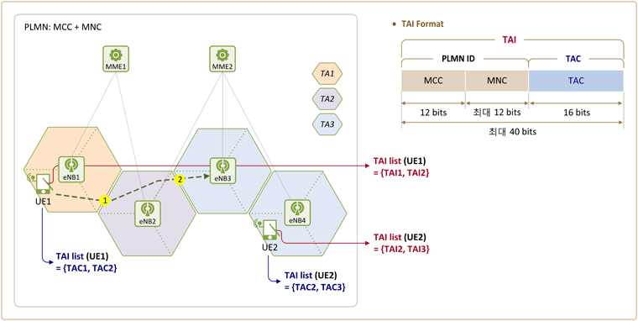
Register Request
3GPP / Non-3GPP/e-call / etc access type
IEI | Information Element | Type/Reference | Presence | Format | Length
 | Extended protocol discriminator | Extended Protocol discriminator 9.2 | M | V | 1
 | Security header type | Security header type 9.3 | M | V | 1/2
 | Spare half octet | Spare half octet 9.5 | M | V | 1/2
 | Registration request message identity | Message type 9.7 | M | V | 1
 | 5GS registration type | 5GS registration type 9.11.3.7 | M | V | 1/2
 | ngKSI | NAS key set identifier 9.11.3.32 | M | V | 1/2
 | 5GS mobile identity | 5GS mobile identity 9.11.3.4 | M | LV-E | 6-n
C- | Non-current native NAS key set identifier | NAS key set identifier 9.11.3.32 | O | TV | 1
10 | 5GMM capability | 5GMM capability 9.11.3.1 | O | TLV | 3-15
2E | UE security capability | UE security capability 9.11.3.54 | O | TLV | 4-10
2F | Requested NSSAI | NSSAI 9.11.3.37 | O | TLV | 4-74
52 | Last visited registered TAI | 5GS tracking area identity 9.11.3.8 | O | TV | 7
17 | S1 UE network capability | S1 UE network capability 9.11.3.48 | O | TLV | 4-15
40 | Uplink data status | Uplink data status 9.11.3.57 | O | TLV | 4-34
50 | PDU session status | PDU session status 9.11.3.44 | O | TLV | 4-34
Network Slicing option
NSSAI (Network Slice Selection Assistance Information)
TAI (Tracking Area Information)

Slide 12
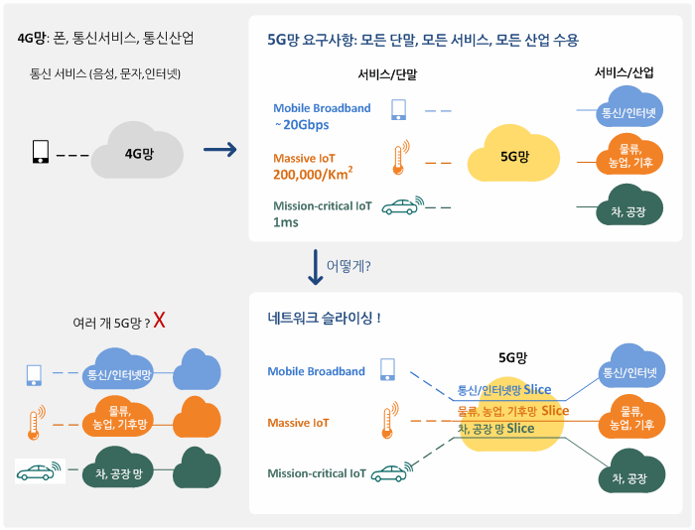
Network Slicing

Slide 13
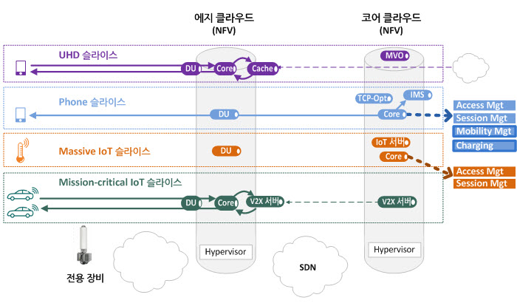
Network Slicing

Slide 14
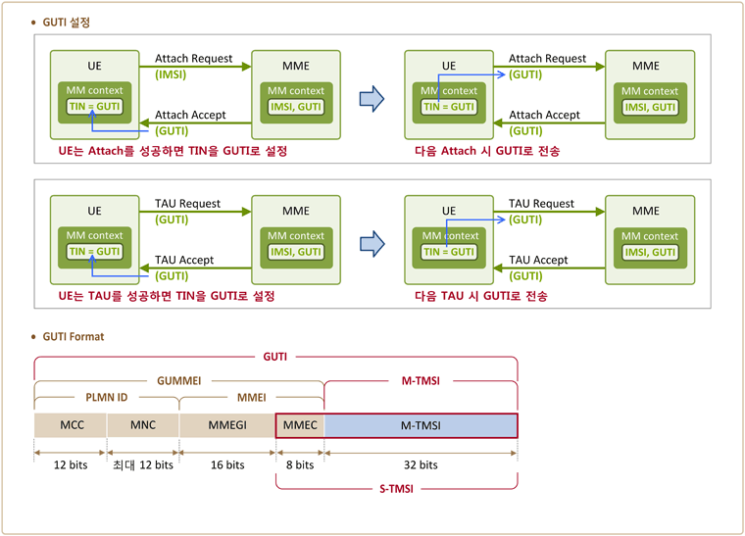
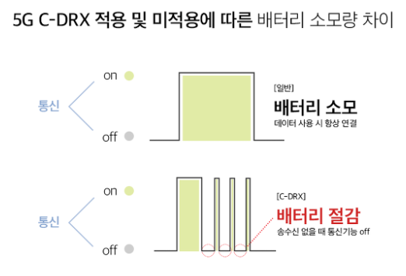
Register Request (2)
GUTI
IEI | Information Element | Type/Reference | Presence | Format | Length
B- | MICO indication | MICO indication 9.11.3.31 | O | TV | 1
2B | UE status | UE status 9.11.3.56 | O | TLV | 3
77 | Additional GUTI | 5GS mobile identity 9.11.3.4 | O | TLV-E | 14
25 | Allowed PDU session status | Allowed PDU session status 9.11.3.13 | O | TLV | 4-34
18 | UE's usage setting | UE's usage setting 9.11.3.55 | O | TLV | 3
51 | Requested DRX parameters | 5GS DRX parameters 9.11.3.2A | O | TLV | 3
70 | EPS NAS message container | EPS NAS message container 9.11.3.24 | O | TLV-E | 4-n
74 | LADN indication | LADN indication 9.11.3.29 | O | TLV-E | 3-811
8- | Payload container type | Payload container type 9.11.3.40 | O | TV | 1
7B | Payload container | Payload container 9.11.3.39 | O | TLV-E | 4-65538
9- | Network slicing indication | Network slicing indication 9.11.3.36 | O | TV | 1
53 | 5GS update type | 5GS update type 9.11.3.9A | O | TLV | 3
41 | Mobile station classmark 2 | Mobile station classmark 2 9.11.3.31C | O | TLV | 5
42 | Supported codecs | Supported codec list 9.11.3.51A | O | TLV | 5-n
71 | NAS message container | NAS message container 9.11.3.33 | O | TLV-E | 4-n
DRX
SMS option, etc

Slide 15
Register Request (3)
IEI | Information Element | Type/Reference | Presence | Format | Length
60 | EPS bearer context status | EPS bearer context status 9.11.3.23A | O | TLV | 4
6E | Requested extended DRX parameters | Extended DRX parameters 9.11.3.26A | O | TLV | 3
6A | T3324 value | GPRS timer 3 9.11.2.5 | O | TLV | 3
67 | UE radio capability ID | UE radio capability ID 9.11.3.68 | O | TLV | 3-n
35 | Requested mapped NSSAI | Mapped NSSAI 9.11.3.31B | O | TLV | 3-42
48 | Additional information requested | Additional information requested 9.11.3.12A | O | TLV | 3
1A | Requested WUS assistance information | WUS assistance information 9.11.3.71 | O | TLV | 3-n
XX | N5GC indication | N5GC indication 9.11.3.72 | O | T | 1
30 | Requested NB-N1 mode DRX parameters | NB-N1 mode DRX parameters 9.11.3.73 | O | TLV | 3

Slide 16
Register Accept
IEI | Information Element | Type/Reference | Presence | Format | Length
 | Extended protocol discriminator | Extended protocol discriminator 9.2 | M | V | 1
 | Security header type | Security header type 9.3 | M | V | 1/2
 | Spare half octet | Spare half octet 9.5 | M | V | 1/2
 | Registration accept message identity | Message type 9.7 | M | V | 1
 | 5GS registration result | 5GS registration result 9.11.3.6 | M | LV | 2
 | 5G-GUTI | 5GS mobile identity 9.11.3.4 | O | TLV-E | 14
 | Equivalent PLMNs | PLMN list 9.11.3.45 | O | TLV | 5-47
C- | TAI list | 5GS tracking area identity list 9.11.3.9 | O | TLV | 9-114
10 | Allowed NSSAI | NSSAI 9.11.3.37 | O | TLV | 4-74
2E | Rejected NSSAI | Rejected NSSAI 9.11.3.46 | O | TLV | 4-42
2F | Configured NSSAI | NSSAI 9.11.3.37 | O | TLV | 4-146
52 | 5GS network feature support | 5GS network feature support 9.11.3.5 | O | TLV | 3-5
17 | PDU session status | PDU session status 9.11.3.44 | O | TLV | 4-34
40 | PDU session reactivation result | PDU session reactivation result 9.11.3.42 | O | TLV | 4-34
50 | PDU session reactivation result error cause | PDU session reactivation result error cause 9.11.3.43 | O | TLV-E | 5-515

Slide 17
Register Accept
IEI | Information Element | Type/Reference | Presence | Format | Length
 | LADN information | LADN information 9.11.3.30 | O | TLV-E | 12-1715
 | MICO indication | MICO indication 9.11.3.31 | O | TV | 1
 | Network slicing indication | Network slicing indication 9.11.3.36 | O | TV | 1
 | Service area list | Service area list 9.11.3.49 | O | TLV | 6-114
 | T3512 value | GPRS timer 3 9.11.2.5 | O | TLV | 3
 | Non-3GPP de-registration timer value | GPRS timer 2 9.11.2.4 | O | TLV | 3
 | T3502 value | GPRS timer 2 9.11.2.4 | O | TLV | 3
C- | Emergency number list | Emergency number list 9.11.3.23 | O | TLV | 5-50
10 | Extended emergency number list | Extended emergency number list 9.11.3.26 | O | TLV-E | 7-65538
2E | SOR transparent container | SOR transparent container 9.11.3.51 | O | TLV-E | 20-n
2F | EAP message | EAP message 9.11.2.2 | O | TLV-E | 7-1503
52 | NSSAI inclusion mode | NSSAI inclusion mode 9.11.3.37A | O | TV | 1
17 | Operator-defined access category definitions | Operator-defined access category definitions 9.11.3.38 | O | TLV-E | 3-n
40 | Negotiated DRX parameters | 5GS DRX parameters 9.11.3.2A | O | TLV | 3
50 | Non-3GPP NW policies | Non-3GPP NW provided policies 9.11.3.36A | O | TV | 1

Slide 18
Register Accept
IEI | Information Element | Type/Reference | Presence | Format | Length
 | EPS bearer context status | EPS bearer context status 9.11.3.23A | O | TLV | 4
 | Negotiated extended DRX parameters | Extended DRX parameters 9.11.3.26A | O | TLV | 3
 | T3447 value | GPRS timer 3 9.11.2.5 | O | TLV | 3
 | T3448 value | GPRS timer 3 9.11.2.4 | O | TLV | 3
 | T3324 value | GPRS timer 3 9.11.2.5 | O | TLV | 3
 | UE radio capability ID | UE radio capability ID 9.11.3.68 | O | TLV | 3-n
 | UE radio capability ID deletion indication | UE radio capability ID deletion indication 9.11.3.69 | O | TV | 1
C- | Pending NSSAI | NSSAI 9.11.3.37 | O | TLV | 4-146
10 | Ciphering key data | Ciphering key data 9.11.3.18C | O | TLV-E | 34-n
2E | CAG information list | CAG information list 9.11.3.18A | O | TLV-E | 3-n
2F | Truncated 5G-S-TMSI configuration | Truncated 5G-S-TMSI configuration 9.11.3.70 | O | TLV | 3
52 | Negotiated WUS assistance information | WUS assistance information 9.11.3.71 | O | TLV | 3-n

Slide 19
Deregisteration

Slide 20
Deregistration request / Accept
IEI | Information Element | Type/Reference | Presence | Format | Length
 | Extended protocol discriminator | Extended protocol discriminator 9.2 | M | V | 1
 | Security header type | Security header type 9.3 | M | V | 1/2
 | Spare half octet | Spare half octet 9.5 | M | V | 1/2
 | De-registration request message identity | Message type 9.7 | M | V | 1
 | De-registration type | De-registration type 9.11.3.20 | M | V | 1/2
 | ngKSI | NAS key set identifier 9.11.3.32 | M | V | 1/2
 | 5GS mobile identity | 5GS mobile identity 9.11.3.4 | M | LV-E | 6-n
IEI | Information Element | Type/Reference | Presence | Format | Length
 | Extended protocol discriminator | Extended protocol discriminator 9.2 | M | V | 1
 | Security header type | Security header type 9.3 | M | V | 1/2
 | Spare half octet | Spare half octet 9.5 | M | V | 1/2
 | De-registration accept message identity | Message type 9.7 | M | V | 1

Slide 21
Deregistration request / Accept ( UE terminated )
IEI | Information Element | Type/Reference | Presence | Format | Length
 | Extended protocol discriminator | Extended protocol discriminator 9.2 | M | V | 1
 | Security header type | Security header type 9.3 | M | V | 1/2
 | Spare half octet | Spare half octet 9.5 | M | V | 1/2
 | De-registration request message identity | Message type 9.7 | M | V | 1
 | De-registration type | De-registration type 9.11.3.20 | M | V | 1/2
 | Spare half octet | Spare half octet 9.5 | M | V | 1/2
58 | 5GMM cause | 5GMM cause 9.11.3.2 | O | TV | 2
5F | T3346 value | GPRS timer 2 9.11.2.4 | O | TLV | 3
6D | Rejected NSSAI | Rejected NSSAI 9.11.3.46 | O | TLV | 4-42
IEI | Information Element | Type/Reference | Presence | Format | Length
 | Extended protocol discriminator | Extended protocol discriminator 9.2 | M | V | 1
 | Security header type | Security header type 9.3 | M | V | 1/2
 | Spare half octet | Spare half octet 9.5 | M | V | 1/2
 | De-registration accept message identity | Message type 9.7 | M | V | 1

Slide 22
Deregistration request / Accept
IEI | Information Element | Type/Reference | Presence | Format | Length
 | Extended protocol discriminator | Extended protocol discriminator 9.2 | M | V | 1
 | Security header type | Security header type 9.3 | M | V | 1/2
 | Spare half octet | Spare half octet 9.5 | M | V | 1/2
 | De-registration request message identity | Message type 9.7 | M | V | 1
 | De-registration type | De-registration type 9.11.3.20 | M | V | 1/2
 | Spare half octet | Spare half octet 9.5 | M | V | 1/2
58 | 5GMM cause | 5GMM cause 9.11.3.2 | O | TV | 2
IEI | Information Element | Type/Reference | Presence | Format | Length
 | Extended protocol discriminator | Extended protocol discriminator 9.2 | M | V | 1
 | Security header type | Security header type 9.3 | M | V | 1/2
 | Spare half octet | Spare half octet 9.5 | M | V | 1/2
 | De-registration accept message identity | Message type 9.7 | M | V | 1

Slide 23
Service Request / Paging
Mobile
IOT
Paging

Slide 24
Service Request
IEI | Information Element | Type/Reference | Presence | Format | Length
 | Extended protocol discriminator | Extended protocol discriminator 9.2 | M | V | 1
 | Security header type | Security header type 9.3 | M | V | 1/2
 | Spare half octet | Spare half octet 9.5 | M | V | 1/2
 | Service request message identity | Message type 9.7 | M | V | 1
 | ngKSI | NAS key set identifier 9.11.3.32 | M | V | 1/2
 | Service type | Service type 9.11.3.50 | M | V | 1/2
 | 5G-S-TMSI | 5GS mobile identity 9.11.3.4 | M | LV-E | 9
40 | Uplink data status | Uplink data status 9.11.3.57 | O | TLV | 4-34
50 | PDU session status | PDU session status 9.11.3.44 | O | TLV | 4-34
25 | Allowed PDU session status | Allowed PDU session status 9.11.3.13 | O | TLV | 4-34
71 | NAS message container | NAS message container 9.11.3.33 | O | TLV-E | 4-n
 | Extended protocol discriminator | Extended protocol discriminator 9.2 | M | V | 1
서버에게 보낼 data 가 존재 할 경우

Slide 25
Service Request Accept
IEI | Information Element | Type/Reference | Presence | Format | Length
 | Extended protocol discriminator | Extended protocol discriminator 9.2 | M | V | 1
 | Security header type | Security header type 9.3 | M | V | 1/2
 | Spare half octet | Spare half octet 9.5 | M | V | 1/2
 | Service accept message identity | Message type 9.7 | M | V | 1
50 | PDU session status | PDU session status 9.11.3.44 | O | TLV | 4-34
26 | PDU session reactivation result | PDU session reactivation result 9.11.3.42 | O | TLV | 4-34
72 | PDU session reactivation result error cause | PDU session reactivation result error cause 9.11.3.43 | O | TLV-E | 5-515
78 | EAP message | EAP message 9.11.2.2 | O | TLV-E | 7-1503
6B | T3448 value | GPRS timer 3 9.11.2.4 | O | TLV | 3

